Slide 1
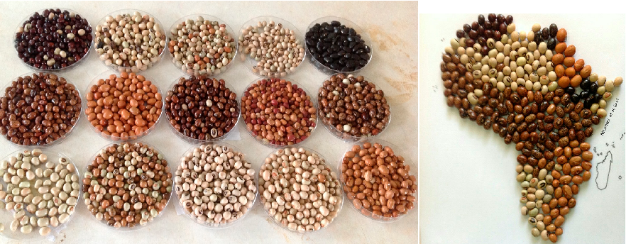
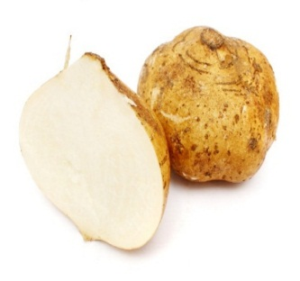
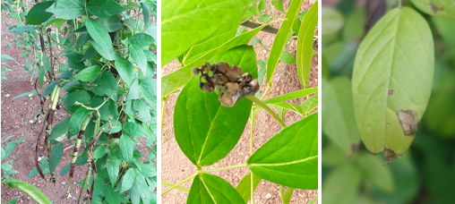
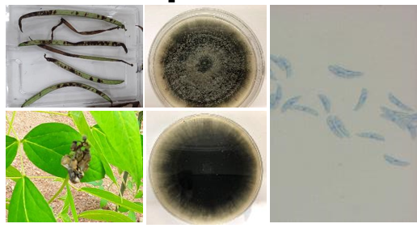
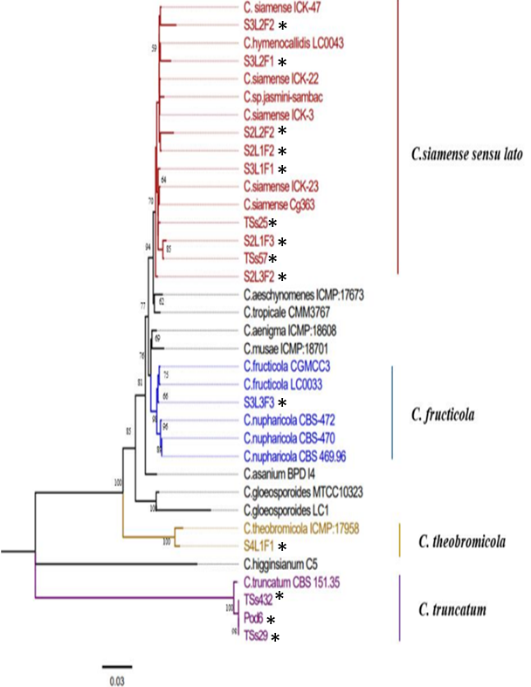
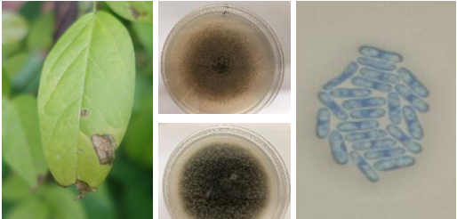
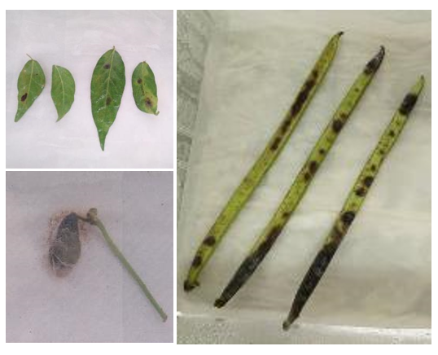




Polyphasic identification of causative pathogens responsible for foliar and pod diseases of African Yam Bean in Nigeria
Olaide Ogunsanya¹²³⁴, Clement Afolabi², Richard Colgan⁴, Andrew Armitage⁴, Elinor Thompson³, Alejandro Ortega-beltran¹, Micheal Abberton¹
¹International Institute of Tropical Agriculture, Ibadan Nigeria, ²Federal University of Agriculture, Abeokuta, Ogun state Nigeria, ³Faculty of Engineering and Science, University of Greenwich, United Kingdom, ⁴Natural Resources Institute, University of Greenwich, United Kingdom
Introduction
African Yam Bean (AYB; Sphenostylis sternocarpa) is an underutilized tuberous legume indigenous to Africa. It serves as a security crop with promises of nutraceutical benefits¹.
Fungal diseases are one of the major factors deterring farmers from large-scale cultivation and germplasm regeneration of AYB².
The causal agent of these diseases are largely uncharacterized.
Objectives
To identify diseases associated with AYB across major AYB growing areas in Nigeria,
To characterize the causative pathogens, employing a polyphasic approach (morphological, molecular, and pathogenicity assays).
1. Identification of diseases associated with AYB in major growing regions
A
B
C
A disease survey was conducted between 2018 and 2019 in five major AYB growing areas in Nigeria; Abia, Enugu, Ebonyi, and Oyo States (Fig. 1).
Pod blight, flower bud rot, and leaf blight diseases were identified across all States surveyed (Fig. 2)
Fig. 1. African Yam Bean disease Survey Sites visited in Nigeria between 2018 and 2019
Fig. 2. Fungal diseases associated with AYB in AYB major growing areas; Pod blight (A); Flower bud rot (B); Leaf blight (C)
2. Polyphasic identification of causative pathogen
Four fungal genera were associated with leaf blight, flower bud rot and pod blight.
The genus Colletotrichum were the most frequently isolated fungi from diseased AYB samples (Fig. 3).
C. gloeosporides species complex were isolated from leaf blight while C. truncatum was isolated from pod blight and flower bud rot (Fig.4a and 4b).
Koch’s postulates were satisfied for C. truncatum on pods and flower buds, and C. gleosporiodes complex on leaves (Fig. 5).
The concatenation of ITS, GAPDH, and CAL sequences revealed the presence of four Colletotrichum species (C. siamense, C. theobromicola, C. fructicola, and C. truncatum) as causative pathogens of AYB foliar and pod diseases.
Fig. 4a. Morphological features of C. truncatum isolated from AYB pod blight and flower bud rot
Fig. 4b. Morphological features of C. gloeosporioides species complex isolated from AYB pod blight and flower bud rot
Fig. 6. Maximum likelihood phylogeny of 14 selected isolates (*) sequencing the ITS, CAL ad GAPDH loci
F2R1
A
C
Conclusions
Leaf blight, pod blight and flower bud rot were identified across all locations surveyed.
A morphological approach alone was not sufficient in delineating the C. gloeosporoides species complex.
The concatenation of ITS, GAPDH and CAL sequences identified three groups of Colletotrichum (C. siamense, C. fructicola, and C. theobromicola) as pathogens causing AYB leaf blight while one group (C. truncatum) as pathogen causing pod blight.
B
Fig. 3. The diversity of fungi associated with African Yam Bean leaves, pods, and flower buds
Fig. 5. Pathogenicity assay; C. gloeosporioides species complex on leaves (A); C. truncatum on flower bud (B); C. truncatum on pods (C)
References
1. Adewale, B. D., Kehinde, O. B., Odu, B. O. and Dumet, D. J. 2008. The potentials of African Yam Bean (Sphenostylis stenocarpa) in Nigeria: character distribution and genetic diversity. In: Smart, J. and Haq, N. New Crops and Uses: Their role in a rapidly changing world. Centre for Underutilised Crops. RPM Print and Design Chichester pp 265-276.
2. Afolabi, C. G., Ogunsanya, O. M, Lawal, O. I. 2019. Evaluation of some African Yam Bean (Sphenostylis Stenocarpa) accessions for resistance to flower bud rot and pod rot diseases. Current plant biology, 100126.

