Slide 1
Stories from the Inside: The narratives of creative writing practitioners in prisons
Dr Ella Simpson
University of Greenwich

Slide 2
Desistance and the Arts
Narrative of transformation constructs the arts as able to change lives for the better (Belfiore and Bennett, 2008)
Most recent review by Cheliotis (2014) = Arts can contribute to desistance through:
psychological and attitudinal changes
learning capacity and motivation
building social skills
Research increasingly neglects the voice of the practitioner, see especially Intermediate Outcomes Measurement Instrument (Maguire et al. 2019: 21)

Slide 3
Relational Dimensions of Arts Interventions
Relationships between prisoners (e.g. Anderson et al, 2011; Caulfield, 2015; De Viggiani et al., 2010)
Prisoner/staff relationships (e.g. McKean, 2006; Nugent and Loucks, 2011; Wilson et al., 2008)
Prisoner and family relationships (e.g. Kinsella and Woodall, 2016; Cox and Gelsthorpe, 2008; Boswell et al., 2011)
Relationships between prisoners and practitioners (e.g. Bilby, Caulfield and Ridley. 2013; Cursley and Maruna, 2015; Albertson, 2015; Tomczak and Albertson, 2016)

Slide 4
Practitioner/Prisoner Relationship
Cursley and Maruna (2015) find success of long term music project is due to relationships participants form with practitioners
Practitioners act as role models ((Van Maanen, 2010; Chelitos, 2014)
Practitioners are seen as ‘“change agents” providing a catalyst for change through meaningful and empowering relationships’ (O’Keefe and Albertson, 2012: 69)
Practitioners are valued for their professional status and ability to set boundaries (Bilby et al, 2013)

Slide 5
The ‘real’ stories of practitioners
‘There is little research that describes what arts practitioners actually do in sessions and, more importantly, how they go about doing it.’ (Anderson, 2015: 372)
Small amount of anecdotal literature (Smith, 1989; Hopwood, 1999; Hadaway, Ward and Menhennet,1993; Flusfeder, 2004; Wade, 2008; Bidder, 2016; Thorn, 2012; Bridgeman, 2013; Gavron, 1996; WIPN, 2020a; Fulleylove, 1998)
My research combines autobiographical narratives of practitioners with a robust narratological analysis

Slide 6
Research Questions
How do creative writing practitioners construct their intentions, motivations and journeys into prison through the stories they craft?
What can these narratives tell us about the work that practitioners do with prisoners?

Slide 7
Methodology
Taking story seriously on its own narrative terms
Moving away from oral narratives to deliberately crafted written stories
Less researcher interpretation more authentic practitioner voice
‘a constitutive view of narrative’’ (Presser, 2009: 184)

Slide 8
Data Collection Method: Eight-Frame Storyboard
19 creative writing practitioners with at least one year’s experience in prison
Participation in one of two creative writing workshops (9 or 10 members in each group)

Slide 9
Methods of Analysis
Narratology (Bal, 2009)
Identify the fabula - the bare bones of the narrative
Actantial Analysis (Greimas, 1966; Herbert, 2011)
Identify key narrative functions - including motivation and goal

Slide 10
6 Types of Alterity
Type of alterity | Art Itself | Anti- authority/ Protest | Reject status quo | Early institutional experience | Identify with/ help the other | Mental health
Number of participants | 8 | 5 | 4 | 3 | 5 | 6

Slide 11
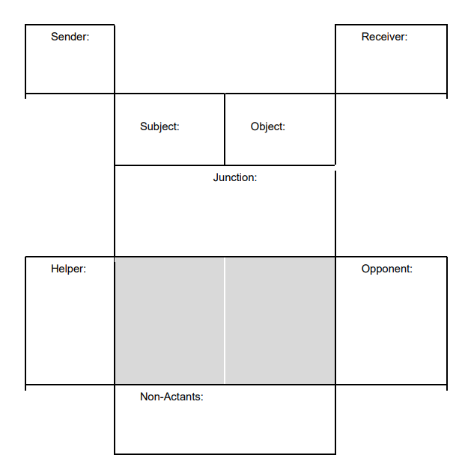
Actantial Analysis (Greimas, 1966)
‘The actantial model enables an action, defined as ‘a syntagmatic organisation of acts’ (Greimas and Courtes, 1984, p. 6)...to be broken up into six structural components, or actantial classes.’
(Simpson, 2022: 86)

Slide 12
Practitioners’ Ambitions
Ambition/Motivation | No. of Practitioners
Professional Creative Ambitions | 3
Abstract Desire to Engage with Process and Practice of the Creative Arts | 7
Non-Creative Professional Ambitions | 2
Personal or Existential Aspirations | 6
Not Amenable to Actantial Analysis | 1
Total | 19

Slide 13
Three Types of Narrative
Individual Narrative | Cultural Narrative (Belfiore and Bennett, 2008)
The Suffering Artist | The Arts as in Crisis and Beleaguerment
The (Inadvertent) Healer | The Arts as Therapeutic
The (Human) Revolutionary | The Arts as Transformative

Slide 14
Practitioners’ Significant Stories
Practitioners are rarely interested in rehabilitating prisoners (n.16)
Most practitioners don’t want to be in prison (n.15)
Majority of practitioners (n.11) have a desire to escape
Over half of practitioners (n.9) resist authority
Almost all practitioners (n.16) have a sense of an outsider status

Slide 15
Shared Stories of Outsiders
Creative practitioners (musicians) and offender (drug users) ‘share the experience of being labelled as outsiders’ (Becker, 1963)
Becker (1963) notes creative practitioners’ unwillingness to made force normal social conventions on others - which aligns with desistance principle of non-judgemental support in work with offenders (McNeill et al., 2012: p.4)
Research increasingly neglects the voice of the practitioner, see especially Intermediate Outcomes Measurement Instrument (Maguire et al. 2019: 21)

Slide 16
Future Stories
Need for authentic stories of practitioners to be included in research on the creative arts in prisons
Research to include prisoners’ authentic stories to better understand relationship dynamics
Use of creative data collection methods to elicit these stories

